Slide 1
Latent Semantic Indexing
Using Singular Vector Decomposition
Dr. Bhuvaneswari A
Assistant Professor
VIT / Chennai

Slide 2
Text is everywhere
We use documents as primary information artifact in our lives
Our access to documents has grown tremendously thanks to the Internet
WWW: webpages, Twitter, Facebook, Wikipedia, Blogs, ...
Digital libraries: Google books, ACM, IEEE, ...
Lyrics, closed caption... (youtube)
Police case reports
Legislation (law)
Reviews (products, rotten tomatoes)
Medical reports (EHR - electronic health records)
Job descriptions
2

Slide 3
Big (Research) Questions
... in understanding and gathering information from text and document collections
•
•
•
establish authorship, authenticity; plagiarism detection
classification of genres for narratives (e.g., books, articles)
tone classification; sentiment analysis (online reviews, twitter, social media)
•
code: syntax analysis (e.g., find common bugs from students’ answers)
3

Slide 4
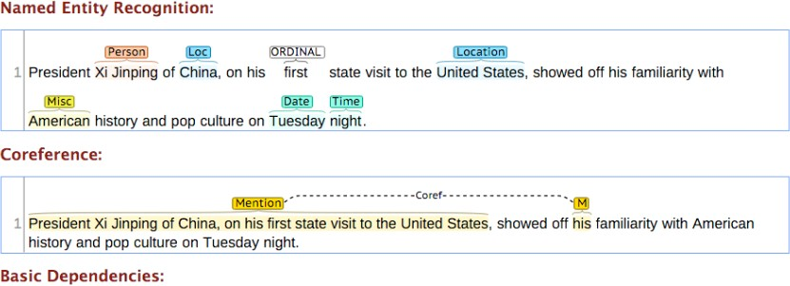
Popular Natural Language Processing
(NLP) libraries
Stanford NLP
tokenization, sentence segmentation, part-of- speech tagging, named entity extraction,
OpenNLP
chunking, parsing
NLTK (python)
Image source: https://stanfordnlp.github.io/CoreNLP/
4

Slide 5
Outline
Preprocessing (e.g., stemming, remove stop words)
Document representation (most common: bag-of- words model)
Word importance (e.g., word count, TF-IDF)
Latent Semantic Indexing (find “concepts” among documents and words), which helps with retrieval
5

Slide 6
Stemming
Reduce words to their stems (or base forms)
Words: compute, computing, computer, ...
Stem: comput
Several classes of algorithms to do this:
Stripping suffixes, lookup-based, etc.
http://en.wikipedia.org/wiki/Stemming
Stop words: http://en.wikipedia.org/wiki/Stop_words
6

Slide 7
Bag-of-words model
Represent each document as a bag of words, ignoring words’ ordering. Why? For simplicity.
Unstructured text becomes a vector of numbers
e.g., docs: “I like visualization”, “I like data”.
1 : “I”
: “like”
: “data”
: “visualization”
“I like visualization” ➡ [1, 1, 0, 1]
“I like data” ➡ [1, 1, 1, 0]
7

Slide 8
TF-IDF
A word’s importance score in a document, among N documents
When to use it? Everywhere you use “word count”, you can likely use TF-IDF.
TF: term frequency
= #appearance a document
(high, if terms appear many times in this document)
IDF: inverse document frequency
= log( N / #document containing that term)
(penalize “common” words appearing in almost any documents)
Final score = TF * IDF
(higher score ➡ more “characteristic”)
Example: http://en.wikipedia.org/wiki/Tf–idf#Example_of_tf.E2.80.93idf
8

Slide 9
Vector Space Model
Why?
Each document ➡ vector Each query ➡ vector
Search for documents ➡ find “similar” vectors Cluster documents ➡ cluster “similar” vectors

Slide 10
Information Retrieval (IR)
Conceptually, IR is the study of finding needed information. I.e., IR helps users find information that matches their information needs.
Expressed as queries
Historically, IR is about document retrieval, emphasizing document as the basic unit.
Finding documents relevant to user queries
Technically, IR studies the acquisition, organization, storage, retrieval, and distribution of information.

Slide 11
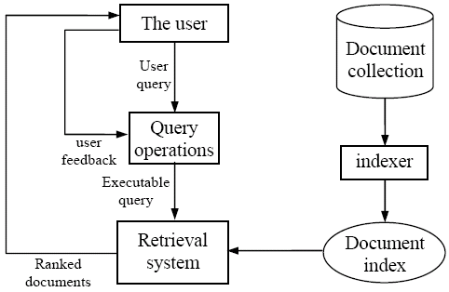
IR architecture

Slide 12
IR queries
Keyword queries
Boolean queries (using AND, OR, NOT)
Phrase queries
Proximity queries
Full document queries
Natural language questions

Slide 13
Information retrieval models
An IR model governs how a document and a query are represented and how the relevance of a document to a user query is defined.
Main models:
Boolean model
Vector space model
Statistical language model
etc

Slide 14
Boolean model
Each document or query is treated as a “bag” of words or terms. Word sequence is not considered.
Given a collection of documents D, let V = {t₁, t₂, ..., t_{|V|}} be the set of distinctive words/terms in the collection. V is called the vocabulary.
A weight w_{ij} > 0 is associated with each term t_{i} of a document d_{j} ∈ D. For a term that does not appear in document d_{j}, w_{ij} = 0.
d_{j} = (w_{1j}, w_{2j}, ..., w_{|V|j}),

Slide 15
Boolean model (contd)
Query terms are combined logically using the Boolean operators AND, OR, and NOT.
E.g., ((data AND mining) AND (NOT text))
Retrieval
Given a Boolean query, the system retrieves every document that makes the query logically true.
Called exact match.
The retrieval results are usually quite poor because term frequency is not considered.

Slide 16
Vector space model
Documents are also treated as a “bag” of words or terms.
Each document is represented as a vector.
However, the term weights are no longer 0 or 1. Each term weight is computed based on some variations of TF or TF-IDF scheme.
Term Frequency (TF) Scheme: The weight of a term t_{i} in document d_{j} is the number of times that t_{i} appears in d_{j}, denoted by f_{ij}. Normalization may also be applied.

Slide 17
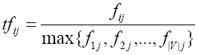
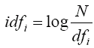
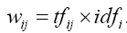
TF-IDF term weighting scheme
The most well known weighting scheme
TF: still term frequency
IDF: inverse document frequency.
N: total number of docs
df_{i}: the number of docs that t_{i} appears.
The final TF-IDF term weight is:

Slide 18
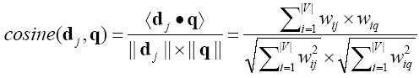
Retrieval in vector space model
Query q is represented in the same way or slightly differently.
Relevance of d_{i} to q: Compare the similarity of query q and document d_{i}.
Cosine similarity (the cosine of the angle between the two vectors)
Cosine is also commonly used in text clustering

Slide 19
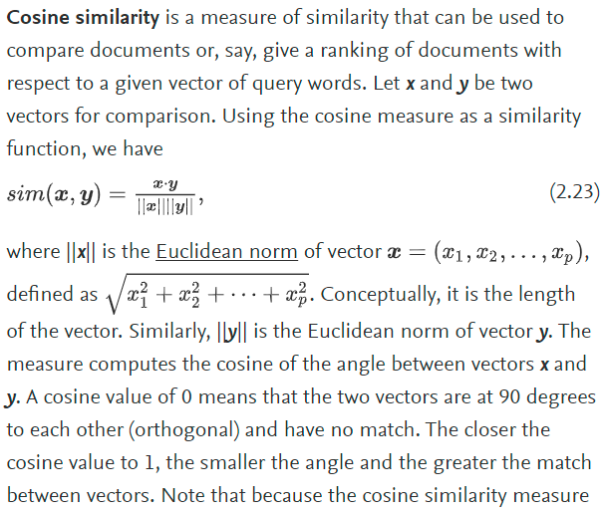

Slide 20
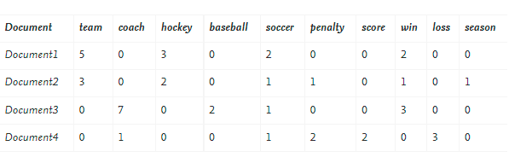
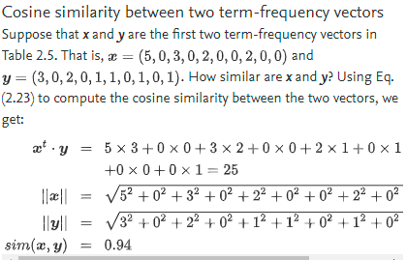
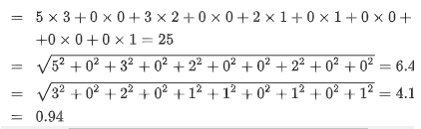

Slide 21
An Example
A document space is defined by three terms:
hardware, software, users
the vocabulary
A set of documents are defined as:
A1=(1, 0, 0), A2=(0, 1, 0), A3=(0, 0, 1)
A4=(1, 1, 0), A5=(1, 0, 1), A6=(0, 1, 1)
A7=(1, 1, 1) A8=(1, 0, 1). A9=(0, 1, 1)
If the Query is “hardware and software”
what documents should be retrieved?

Slide 22
An Example (cont.)
In Boolean query matching:
document A4, A7 will be retrieved (“AND”)
retrieved: A1, A2, A4, A5, A6, A7, A8, A9 (“OR”)
In similarity matching (cosine):
q=(1, 1, 0)
S(q, A1)=0.71, S(q, A2)=0.71, S(q, A3)=0
S(q, A4)=1, S(q, A5)=0.5, S(q, A6)=0.5
S(q, A7)=0.82, S(q, A8)=0.5, S(q, A9)=0.5
Document retrieved set (with ranking)=
{A4, A7, A1, A2, A5, A6, A8, A9}

Slide 23
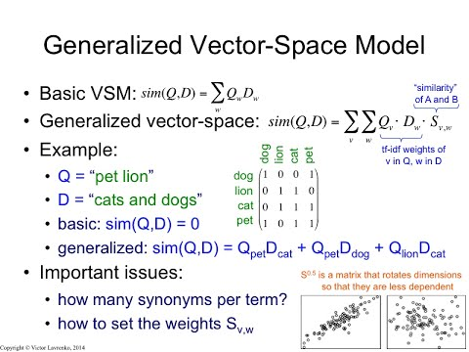

Slide 24
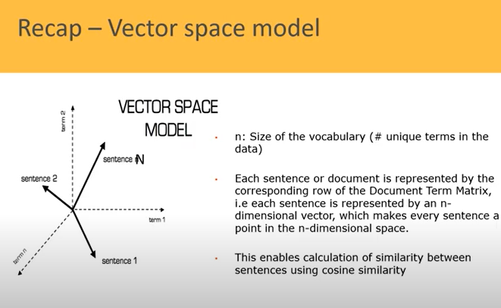

Slide 25
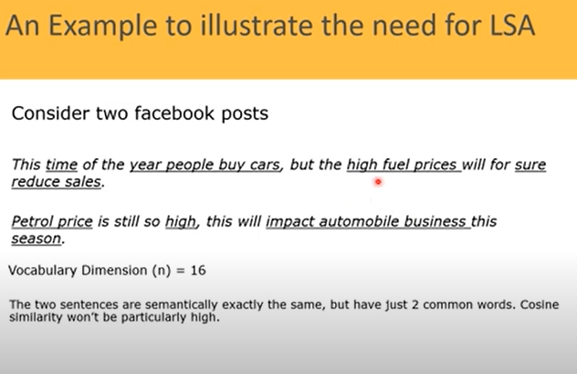

Slide 26
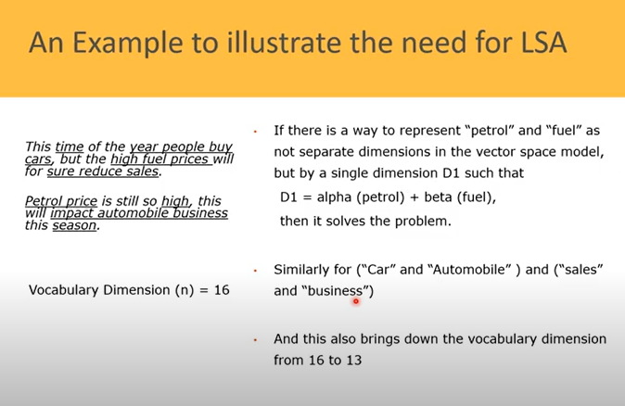

Slide 27
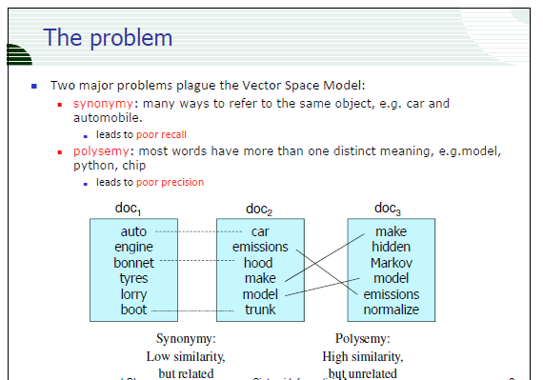

Slide 28
Suffix Trees

Slide 29
Suffix Trees and Suffix Arrays
Each position in the text is considered as a text suffix
Index points are selected form the text, which point to the beginning of the text positions which will be retrievable

Slide 30
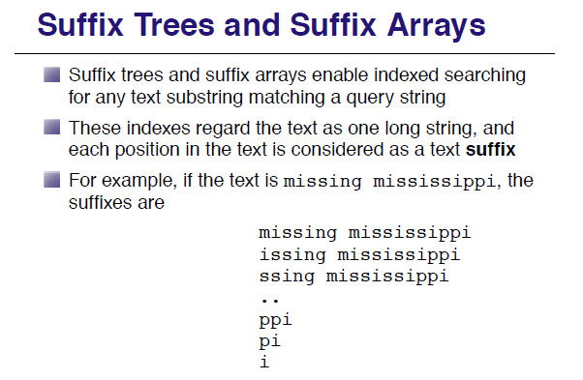

Slide 31
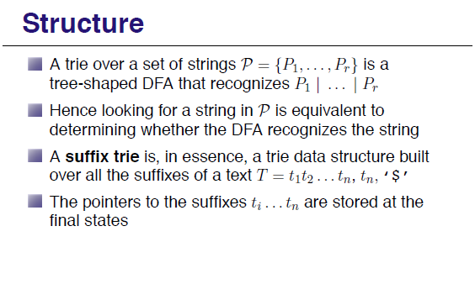

Slide 32
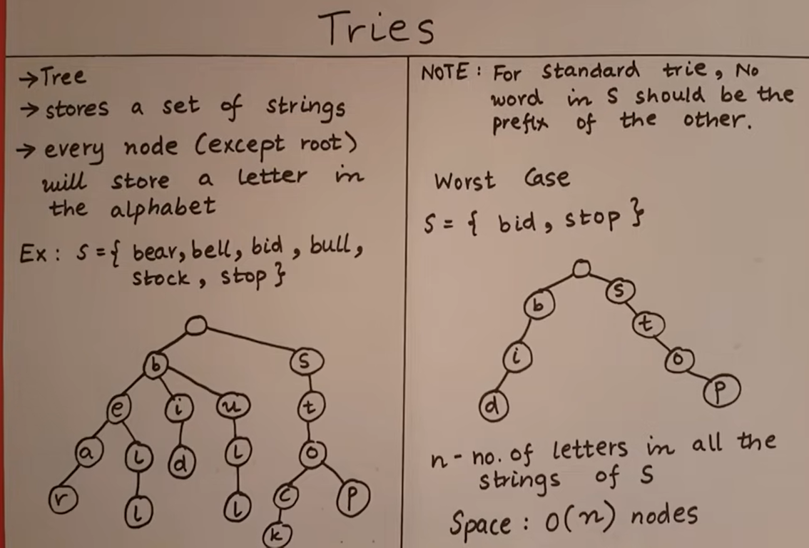

Slide 33
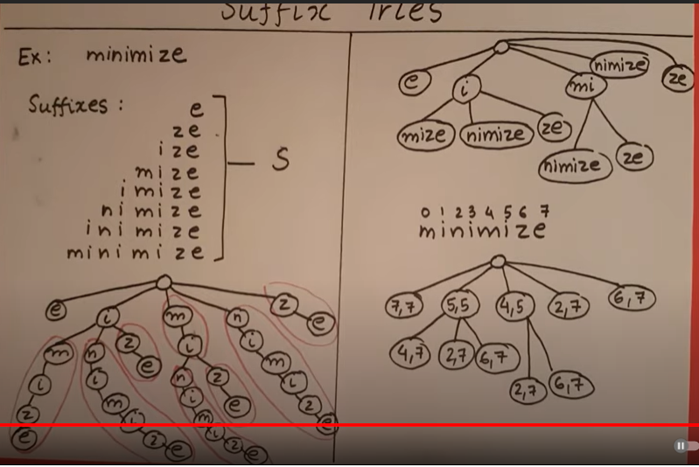

Slide 34
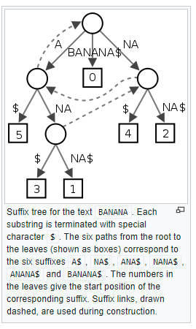
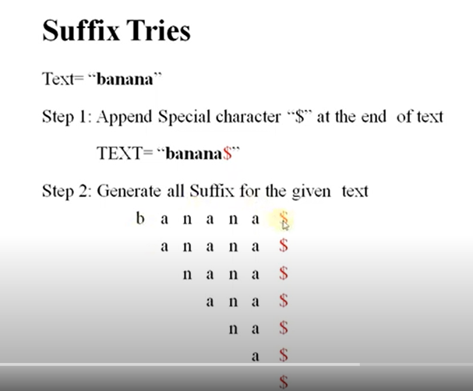

Slide 35
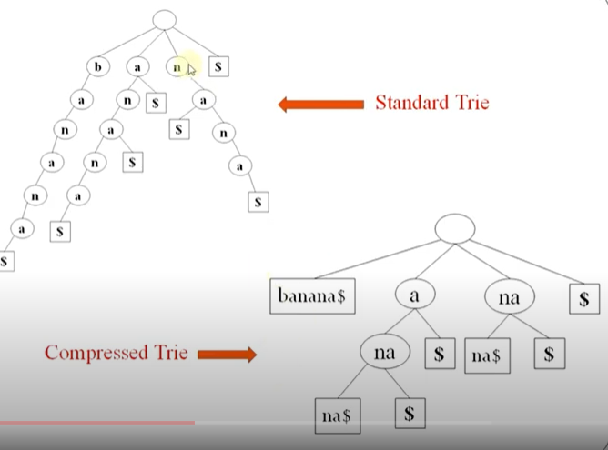

Slide 36
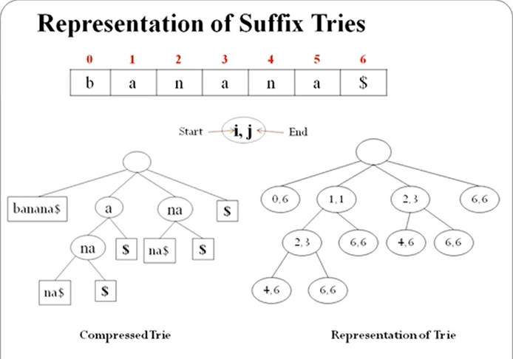

Slide 37
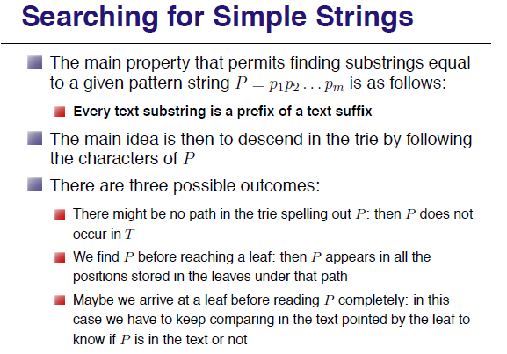

Slide 38
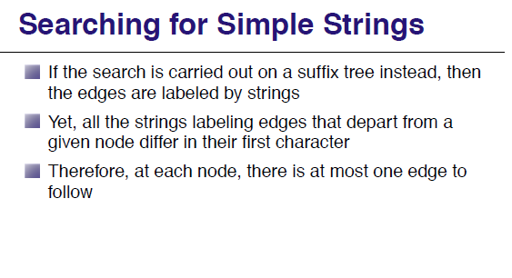

Slide 39
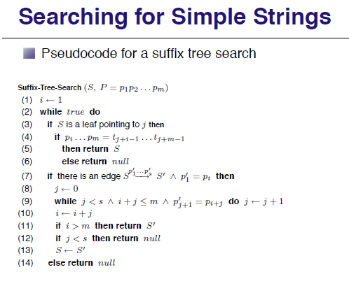

Slide 40
Suffix tree
Pre-requisite : Trie
Suffix tree is a compressed trie of all the suffixes of a given string. Suffix trees help in solving a lot of string related problems like pattern matching, finding distinct substrings in a given string, finding longest palindrome etc.
Compressed Trie
Suffix Tree Construction (Brute Force)

Slide 41
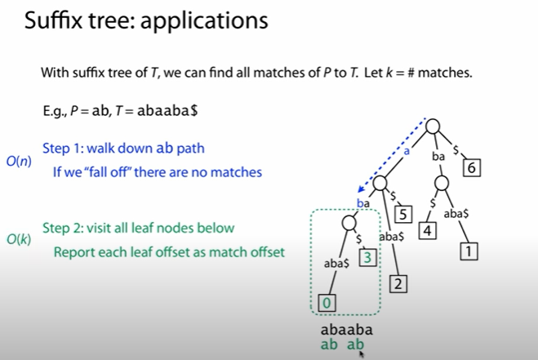

Slide 42
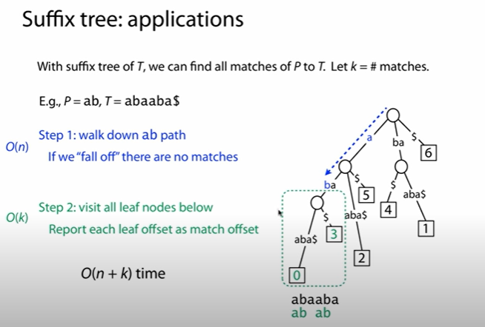

Slide 43
Latent Semantic Indexing (LSI)
Main idea
map each document into some ‘concepts’
map each term into some ‘concepts’
‘Concept’ : ~ a set of terms, with weights. For example, DBMS_concept:
“data” (0.8),
“system” (0.5),

Slide 44
Latent Semantic Indexing (LSI)
~ pictorially (before) ~
document-term matrix
 | data | system | retireval | lung | ear
doc1 | 1 | 1 | 1
doc2 | 1 | 1 | 1
doc3 |  |  |  | 1 | 1
doc4 |  |  |  | 1 | 1

Slide 45
Latent Semantic Indexing (LSI)
~ pictorially (after) ~
… and
document-concept
matrix
term-concept
matrix
 | database concept | medical concept |  |  | database concept | medical concept
data | 1 |  |  | doc1 | 1
system | 1 |  |  | doc2 | 1
retrieval | 1 |  |  | doc3 |  | 1
lung |  | 1 |  | doc4 |  | 1
ear |  | 1

Slide 46





Latent Semantic Indexing (LSI)
Q: How to search, e.g., for “system”?
A: find the corresponding concept(s); and the corresponding documents
 | database concept | medical concept |  |  | database concept | medical concept
data | 1 |  |  | doc1 | 1
system | 1 |  |  | doc2 | 1
retrieval | 1 |  |  | doc3 |  | 1
lung |  | 1 |  | doc4 |  | 1
ear |  | 1

Slide 47
Latent Semantic Indexing (LSI)
Works like an automatically constructed thesaurus
We may retrieve documents that DON’T have the term “system”, but they contain almost everything else (“data”, “retrieval”)

Slide 48
LSI - Discussion
Great idea,
to derive ‘concepts’ from documents
to build a ‘thesaurus’ automatically
to reduce dimensionality (down to few “concepts”)
How does LSI work?
Uses Singular Value Decomposition (SVD)

Slide 49


Singular Value Decomposition (SVD)
Motivation
tomatos
bread
lettuce
chicken
beef
Problem #1
Find “concepts” in matrices
1 | 1 | 1
2 | 2 | 2
1 | 1 | 1
5 | 5 | 5
 |  |  | 2 | 2
 |  |  | 3 | 3
 |  |  | 1 | 1
vegetarians
Problem #2
Compression / dimensionality reduction
meat eaters

Slide 50
SVD is a powerful, generalizable technique.
Songs / Movies / Products
1 | 1 | 1
2 | 2 | 2
1 | 1 | 1
5 | 5 | 5
 |  |  | 2 | 2
 |  |  | 3 | 3
 |  |  | 1 | 1
Customers

Slide 51
SVD Definition (pictorially)
^{A}[n x m] ^{= U}[n x r] ^{Λ} [r x r] ^{(V}[m x r]^{)T}
m
r
r
m
n
=
n
x
r
x
r
Diagonal matrix Diagonal entries: concept strengths
m terms
r concepts
n documents
m terms
n documents
r concepts

Slide 52
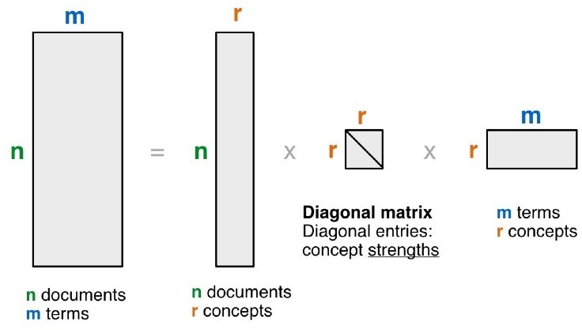
SVD Definition (in words)
^{A}[n x m] ^{= U}[n x r] ^{Λ} [r x r] ^{(V}[m x r]^{)T}
A: n x m matrix
e.g., n documents, m terms
U: n x r matrix
Document Concept Similarity Matrix
e.g., n documents, r concepts
Λ: r x r diagonal matrix
Concept Matrix
r : rank of the matrix; strength of each ‘concept’
V: m x r matrix
Term Concept Similarity Matrix
e.g., m terms, r concepts

Slide 53
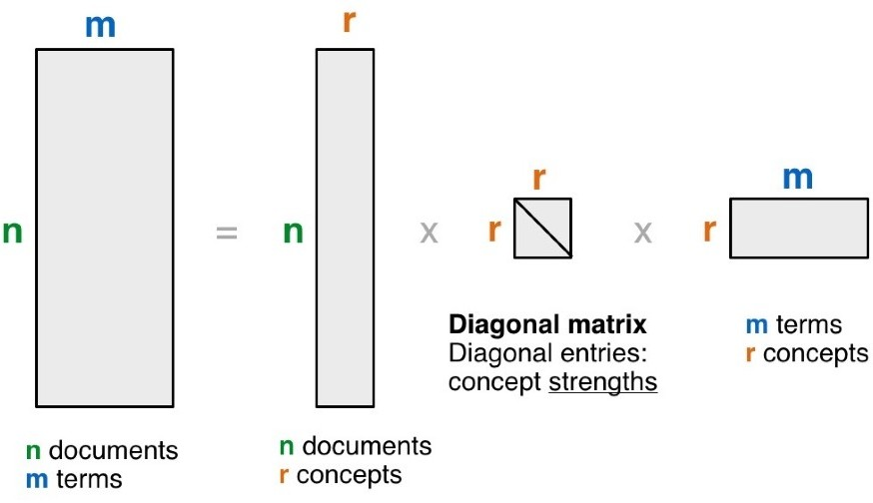
SVD - Properties
THEOREM [Press+92]:
always possible to decompose matrix A into
A = U Λ V^{T}
U, Λ, V: unique, most of the time
U, V: column orthonormal
i.e., columns are unit vectors, and orthogonal to each other
U^{T} U = I
(I: identity matrix)
V^{T} V = I
Λ: diagonal matrix with non-negative diagonal entires, sorted in decreasing order

Slide 54
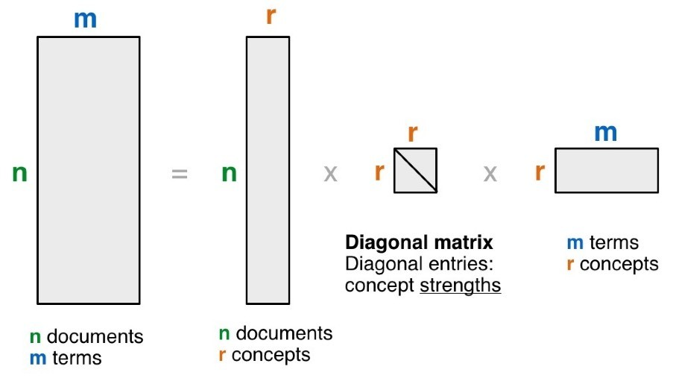


_{V}T
A = U Λ
SVD - Example
retrieval
data
info
brain
lung
1 | 1 | 1 | 0 | 0
2 | 2 | 2 | 0 | 0
1 | 1 | 1 | 0 | 0
5 | 5 | 5 | 0 | 0
0 | 0 | 0 | 2 | 2
0 | 0 | 0 | 3 | 3
0 | 0 | 0 | 1 | 1
0.18 | 0
0.36 | 0
0.18 | 0
0.90 | 0
0 | 0.53
0 | 0.80
0 | 0.27
CS
docs
9.64 | 0
0 | 5.29
0.58 | 0.58 | 0.58 | 0 | 0
0 | 0 | 0 | 0.71 | 0.71
=
x
x
MD
docs

Slide 55






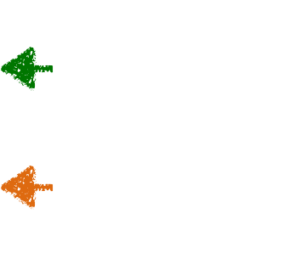

SVD - Example
MD
concept
CS
concept
“strength” of CS-concept
retrieval
0.18 | 0
0.36 | 0
0.18 | 0
0.90 | 0
0 | 0.53
0 | 0.80
0 | 0.27
data
info
brain
lung
1 | 1 | 1 | 0 | 0
2 | 2 | 2 | 0 | 0
1 | 1 | 1 | 0 | 0
5 | 5 | 5 | 0 | 0
0 | 0 | 0 | 2 | 2
0 | 0 | 0 | 3 | 3
0 | 0 | 0 | 1 | 1
retrieval
CS
data
info
brain
lung
docs
9.64 | 0
0 | 5.29
0.58 | 0.58 | 0.58 | 0 | 0
0 | 0 | 0 | 0.71 | 0.71
CS
concept
MD
concept
=
x
x
MD
term-concept
similarity matrix
docs
document-concept
similarity matrix

Slide 56
SVD - Interpretation #1
‘documents’, ‘terms’ and ‘concepts’:
U: document-concept similarity matrix
V: term-concept similarity matrix
Λ: diagonal elements: concept “strengths”

Slide 57
SVD - Interpretation #1
‘documents’, ‘terms’ and ‘concepts’: Q: if A is the document-to-term matrix,
what is the similarity matrix A^{T} A ?
A:
Q: A A^{T} ? A:

Slide 58
SVD - Interpretation #1
‘documents’, ‘terms’ and ‘concepts’: Q: if A is the document-to-term matrix,
what is the similarity matrix A^{T} A ?
A: term-to-term ([m x m]) similarity matrix
Q: A A^{T} ?
A: document-to-document ([n x n]) similarity matrix

Slide 59
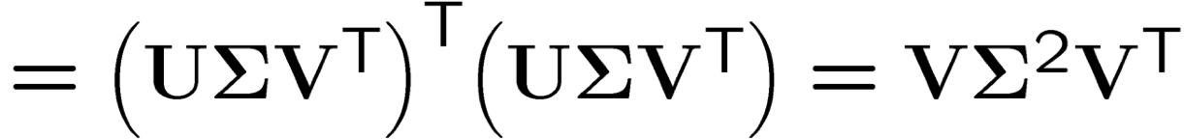
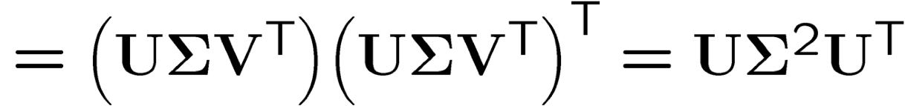
SVD properties
V are the eigenvectors of the covariance matrix A^{T}A
A^{T}A
U are the eigenvectors of the Gram (inner-product) matrix AA^{T}
AA^{T}
SVD is closely related to PCA, and can be numerically more stable.
For more info, see:
http://math.stackexchange.com/questions/3869/what-is-the-intuitive-relationship-between-svd-and-pca Ian T. Jolliffe, Principal Component Analysis (2nd ed), Springer, 2002. Gilbert Strang, Linear Algebra and Its Applications (4th ed), Brooks Cole, 2005.

Slide 60
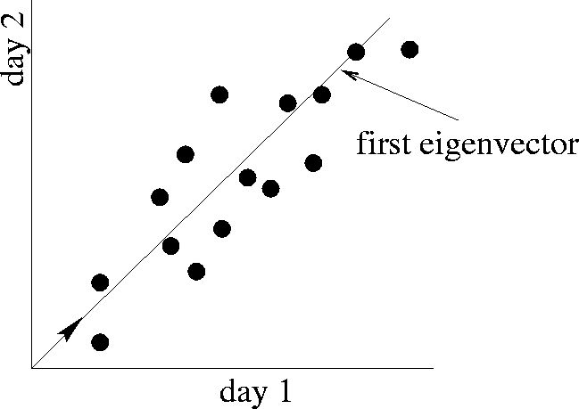
SVD - Interpretation #2
Find the best axis to project on.
(‘best’ = min sum of squares of projection errors)
First Singular Vector
v1
min RMS error
Beautiful visualization explaining PCA:
http://setosa.io/ev/principal-component-analysis/

Slide 61
SVD - Interpretation #2
More details
Q: how exactly is dim. reduction done?
0.18 | 0
0.36 | 0
0.18 | 0
0.90 | 0
0 | 0.53
0 | 0.80
0 | 0.27
1 | 1 | 1 | 0 | 0
2 | 2 | 2 | 0 | 0
1 | 1 | 1 | 0 | 0
5 | 5 | 5 | 0 | 0
0 | 0 | 0 | 2 | 2
0 | 0 | 0 | 3 | 3
0 | 0 | 0 | 1 | 1
9.64 | 0
0 | 5.29
0.58 | 0.58 | 0.58 | 0 | 0
0 | 0 | 0 | 0.71 | 0.71
=
x
x

Slide 62

SVD - Interpretation #2
More details
Q: how exactly is dim. reduction done?
A: set the smallest singular values to zero:
0.18 | 0
0.36 | 0
0.18 | 0
0.90 | 0
0 | 0.53
0 | 0.80
0 | 0.27
1 | 1 | 1 | 0 | 0
2 | 2 | 2 | 0 | 0
1 | 1 | 1 | 0 | 0
5 | 5 | 5 | 0 | 0
0 | 0 | 0 | 2 | 2
0 | 0 | 0 | 3 | 3
0 | 0 | 0 | 1 | 1
9.64 | 0
0 | 5.29
0.58 | 0.58 | 0.58 | 0 | 0
0 | 0 | 0 | 0.71 | 0.71
=
x
x

Slide 63


SVD - Interpretation #2
More details
Q: how exactly is dim. reduction done?
A: set the smallest singular values to zero:
0.18 | 0
0.36 | 0
0.18 | 0
0.90 | 0
0 | 0.53
0 | 0.80
0 | 0.27
1 | 1 | 1 | 0 | 0
2 | 2 | 2 | 0 | 0
1 | 1 | 1 | 0 | 0
5 | 5 | 5 | 0 | 0
0 | 0 | 0 | 2 | 2
0 | 0 | 0 | 3 | 3
0 | 0 | 0 | 1 | 1
9.64 | 0
0 | 5.29
0.58 | 0.58 | 0.58 | 0 | 0
0 | 0 | 0 | 0.71 | 0.71
=
x
x

Slide 64
SVD - Interpretation #2
More details
Q: how exactly is dim. reduction done?
A: set the smallest singular values to zero:
0.18
0.36
0.18
0.90
0
0
0
1 | 1 | 1 | 0 | 0
2 | 2 | 2 | 0 | 0
1 | 1 | 1 | 0 | 0
5 | 5 | 5 | 0 | 0
0 | 0 | 0 | 2 | 2
0 | 0 | 0 | 3 | 3
0 | 0 | 0 | 1 | 1
9.64 | 0
0
0.58 | 0.58 | 0.58 | 0 | 0
=
x
x

Slide 65

SVD - Interpretation #2
More details
Q: how exactly is dim. reduction done?
A: set the smallest singular values to zero:
1 | 1 | 1 | 0 | 0
2 | 2 | 2 | 0 | 0
1 | 1 | 1 | 0 | 0
5 | 5 | 5 | 0 | 0
0 | 0 | 0 | 2 | 2
0 | 0 | 0 | 3 | 3
0 | 0 | 0 | 1 | 1
1 | 1 | 1 | 0 | 0
2 | 2 | 2 | 0 | 0
1 | 1 | 1 | 0 | 0
5 | 5 | 5 | 0 | 0
0 | 0 | 0 | 0 | 0
0 | 0 | 0 | 0 | 0
0 | 0 | 0 | 0 | 0
~

Slide 66
Case Study
How to do queries with LSI?

Slide 67


How to do queries with LSI?
Case Study
For example, how to find documents with ‘data’?
retrieval
0.18 | 0
0.36 | 0
0.18 | 0
0.90 | 0
0 | 0.53
0 | 0.80
0 | 0.27
data
info
brain
lung
1 | 1 | 1 | 0 | 0
2 | 2 | 2 | 0 | 0
1 | 1 | 1 | 0 | 0
5 | 5 | 5 | 0 | 0
0 | 0 | 0 | 2 | 2
0 | 0 | 0 | 3 | 3
0 | 0 | 0 | 1 | 1
CS
docs
9.64 | 0
0 | 5.29
0.58 | 0.58 | 0.58 | 0 | 0
0 | 0 | 0 | 0.71 | 0.71
=
x
x
MD
docs

Slide 68
How to do queries with LSI?
Case Study
For example, how to find documents with ‘data’? A: map query vectors into ‘concept space’ – how?
retrieval
0.18 | 0
0.36 | 0
0.18 | 0
0.90 | 0
0 | 0.53
0 | 0.80
0 | 0.27
data
info
brain
lung
1 | 1 | 1 | 0 | 0
2 | 2 | 2 | 0 | 0
1 | 1 | 1 | 0 | 0
5 | 5 | 5 | 0 | 0
0 | 0 | 0 | 2 | 2
0 | 0 | 0 | 3 | 3
0 | 0 | 0 | 1 | 1
CS
docs
9.64 | 0
0 | 5.29
0.58 | 0.58 | 0.58 | 0 | 0
0 | 0 | 0 | 0.71 | 0.71
=
x
x
MD
docs

Slide 69

How to do queries with LSI?
Case Study
For example, how to find documents with ‘data’? A: map query vectors into ‘concept space’, using inner product (cosine similarity) with each ‘concept’ vector v_{i}
q
retrieval
data
info
brain
lung
q =
1 | 0 | 0 | 0 | 0
v2
v1
q o v1
term1

Slide 70

How to do queries with LSI?
Case Study
Compactly, we have:
^{q V = q}concept
0.58 | 0
0.58 | 0
0.58 | 0
0 | 0.71
0 | 0.71
1 | 0 | 0 | 0 | 0
=
0.58 0
data
info
brain
lung
CS
concept
term-concept
similarity matrix
retrieval

Slide 71
Case Study
How would the document (‘information’, ‘retrieval’) be handled?

Slide 72
How would the document (‘information’, ‘retrieval’) be handled?
Case Study
SAME!
^{q V = d}concept
0.58 | 0
0.58 | 0
0.58 | 0
0 | 0.71
0 | 0.71
0 | 1 | 1 | 0 | 0
=
1.16 0
data
info
brain
lung
CS
concept
term-concept
similarity matrix
retrieval

Slide 73



Observation
Case Study
Document (‘information’, ‘retrieval’) will be retrieved by query (‘data’), even though it does not contain ‘data’!!
Query strongly associates with CS concept
retrieval
data
info
brain
lung
query
1 | 0 | 0 | 0 | 0
0.58 0
Map to concept space
document
0 | 1 | 1 | 0 | 0
1.16 0
Un-map from concept space

Slide 74
Switch Gear to
Text Visualization
47

Slide 75
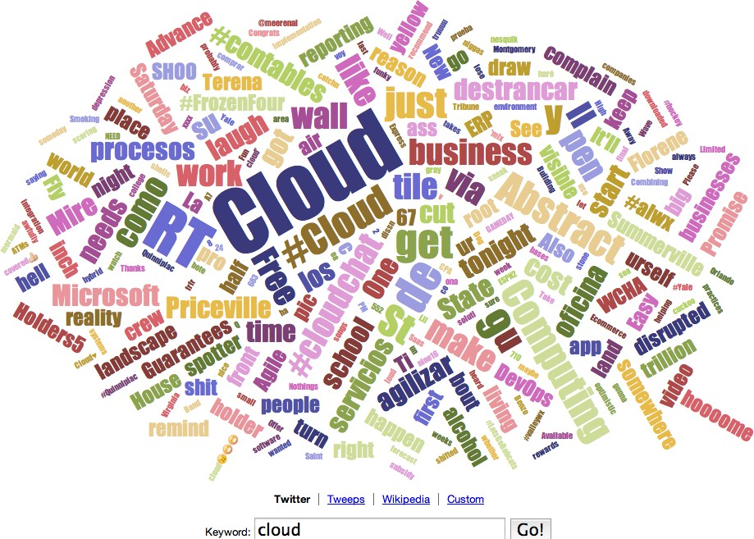
Word/Tag Cloud (still popular?)
http://www.wordle.net
48

Slide 76
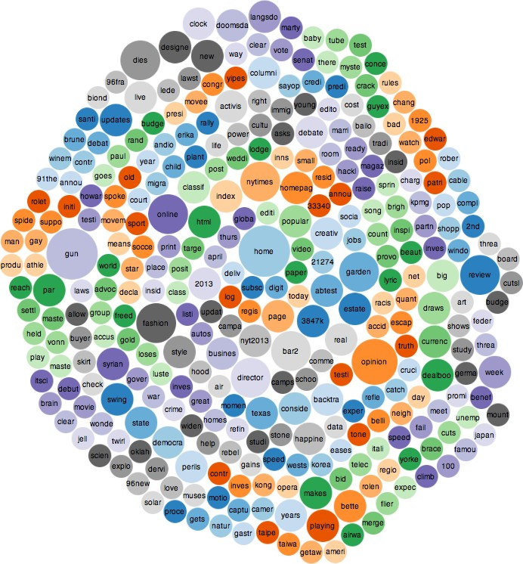
Word Counts (words as bubbles)
http://www.infocaptor.com/bubble-my-page
49

Slide 77
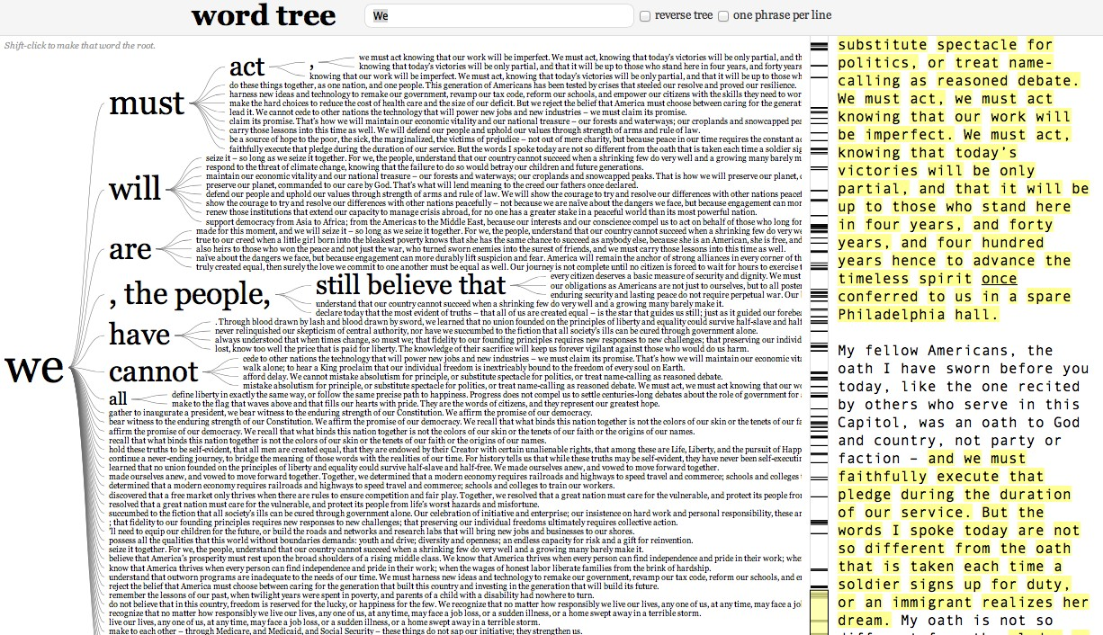
Word Tree
http://www.jasondavies.com/wordtree/
50

Slide 78
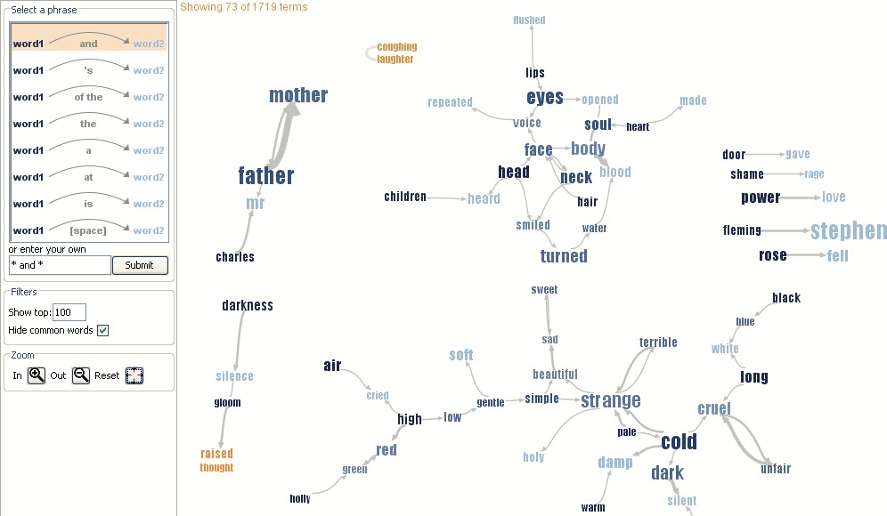
Phrase Net
Visualize pairs of words satisfying a pattern (“X and Y”)
51
http://hint.fm/projects/phrasenet/

Slide 79
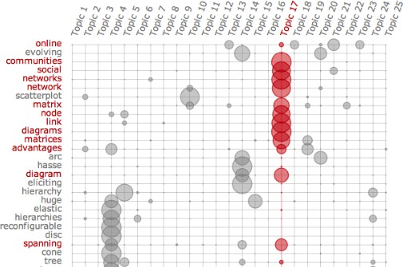
Termite: Topic Model Visualization
http://vis.stanford.edu/papers/termite

Slide 80
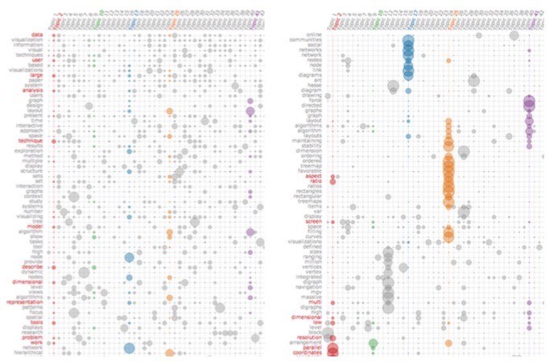
Termite: Topic Model Visualization^{Analy}
http://vis.stanford.edu/papers/termite
Using “Seriation”

